Slide 1
CSE 2050: Intro to Data Structures and Object-Oriented Design
Module 04: Linear Data Structures
Prof. Tim Curry & Jake Scoggin

Slide 2
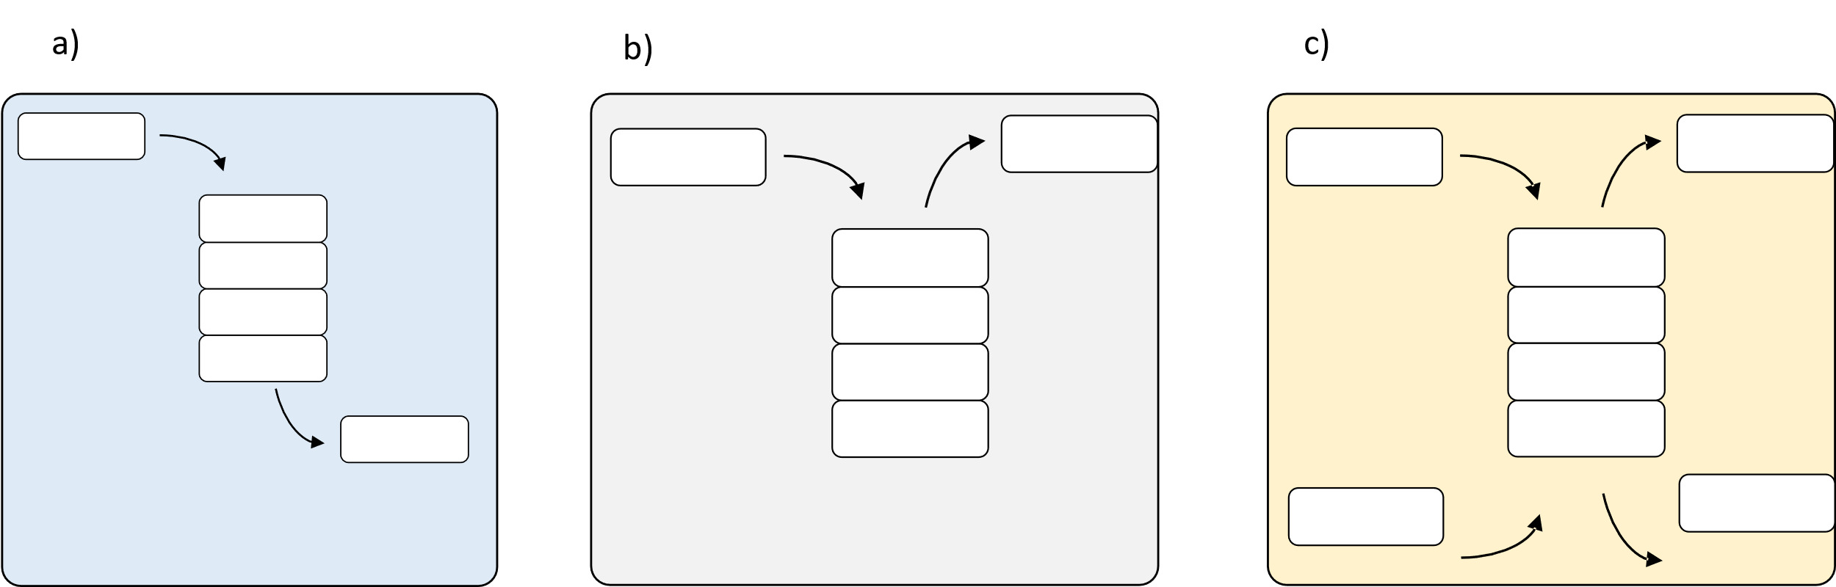

Slide 3


Slide 4
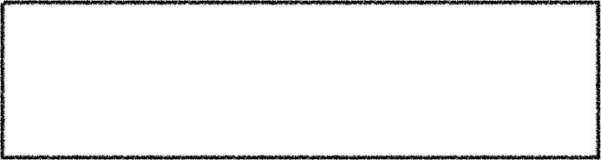
Abstract Data Types (ADTs)
ADT
supported operations
An abstract data type (ADT) is a model for a collection of data
Defined by its behavior (semantics) from a user’s perspective
A data structure is an implementation of an ADT
Data structures are the concrete representations of the underlying data
Perspective of the implementer
An ADT should be completely independent from its implementation
Abstraction
Encapsulation
user
data structure
}
When we implement ADTs in Python, we will package them as classes

Slide 5
Deque ADT
Stack ADT
Queue ADT
add_first()
add_last()
remove_first()
remove_last()
list
push()
pop()
list
enqueue()
dequeue()
list
user
user
user
What is the running time for each operation?

Slide 7
The Stack ADT

Slide 8
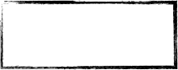
The Stack ADT
Stack
Stack
Our First ADT
Last In, Last Out
A collection of items with the following behavior (i.e., public interface/methods)
push(item) : adds item to the stack
pop() : removes and returns the next item in a Last In First Out (LIFO) ordering
peek() : returns the next item in a LIFO ordering
size() : returns the number of items in the stack
Since we are in Python, we’ll implement the __len__ magic method
is_empty() : returns True if the stack has no items and returns False otherwise
Examples of uses
CPU organization, algorithms (depth-first search), syntax parsing
8
3
1

Slide 9
The Stack ADT
Example
Stack
push(1)
push(3)
push(8)
pop()
—> 8
8
peek()
3
—> 3
1
isEmpty()
—> False

Slide 10
Class Exercise
Implement a Stack class that supports push, pop, peek, len, and is_empty.
Starter code in shared_material/slides_scoggin/mod04_code

Slide 11
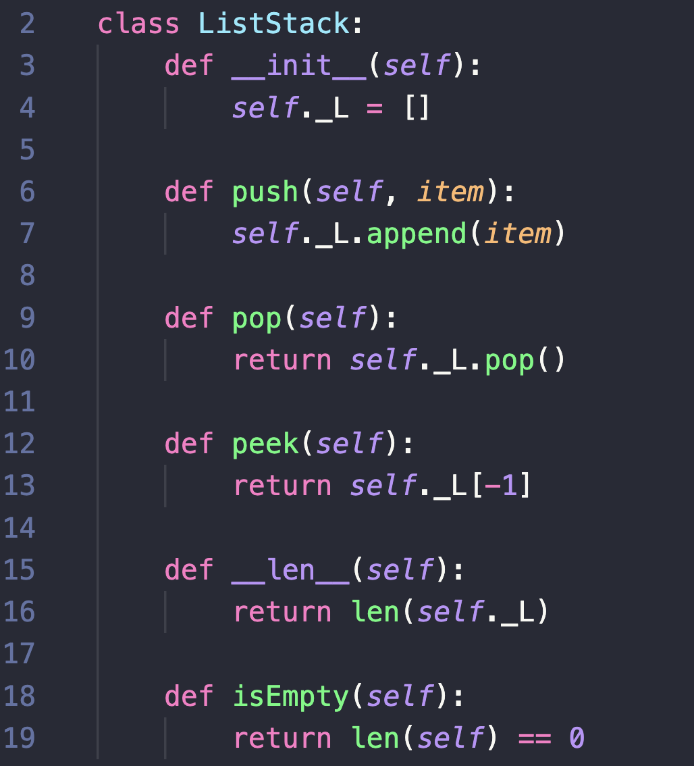


The Stack ADT
Implementation: Using a Python List

Slide 12
The Stack ADT
Implementation: Using a Python List
13
push(item)
11
5
9
2
6

Slide 13
The Stack ADT
Implementation: Using a Python List
pop()
11
5
9
2
6

Slide 14
The Stack ADT
Implementation: Using a Python List
peek()
11
5
9
2
6

Slide 15
The Stack ADT
Implementation: Using a Python List

Slide 16
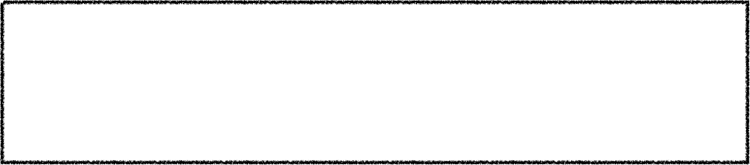
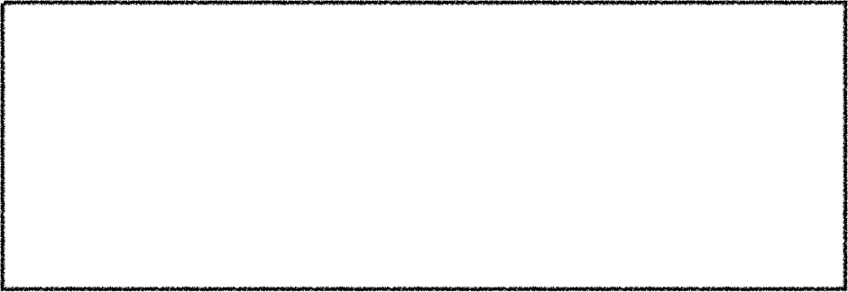
The Stack ADT
Implementation: Using a Python List
This is an example of the Wrapper Pattern
Behind the scenes, the Python List is doing all the heavy lifting. In reality, we’ve just wrapped our own interface around it. This is also an example of composition.

Slide 17
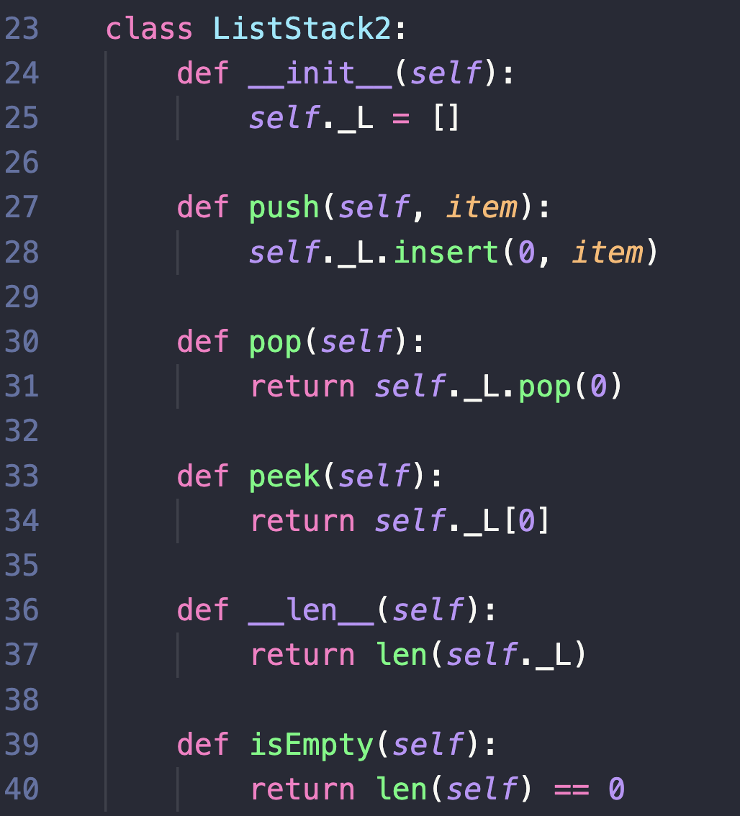
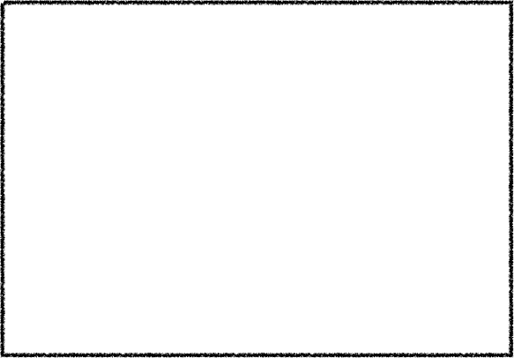
The Stack ADT
Another Implementation Using a Python List
Is one better than the other? Or are they equivalent?

Slide 18
The Stack ADT
Running Time Analysis
O(1)
O(n)
O(1)
O(n)
O(1)
O(1)
O(1)
O(1)
O(1)
O(1)

Slide 19
The Queue ADT

Slide 20
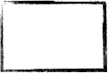
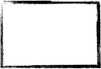
The Queue ADT
Queue
First In, First Out
8
3
1
A collection of items with the following behavior (i.e., methods)
enqueue(item) : adds item to the queue
dequeue() : removes and returns the next item in a First In First Out (FIFO) ordering
peek() : returns the next item in a FIFO ordering
size() : returns the number of items in the queue
Since we are in Python, we’ll implement the __len__ magic method
isEmpty() : returns True if the queue has no items and returns False otherwise
Examples of uses
Resource allocation, printer job queue, algorithms (breadth-first search)

Slide 21
The Queue ADT
Example
Queue
enqueue(1)
enqueue(3)
enqueue(8)
dequeue()
1
3
8
—> 1
peek()
—> 3
isEmpty()
—> False

Slide 22
Class Exercise
Implement a QUeue class that supports enqueue, dequeue, peek, len, and is_empty.
Starter code in shared_material/slides_scoggin/mod04_code

Slide 23
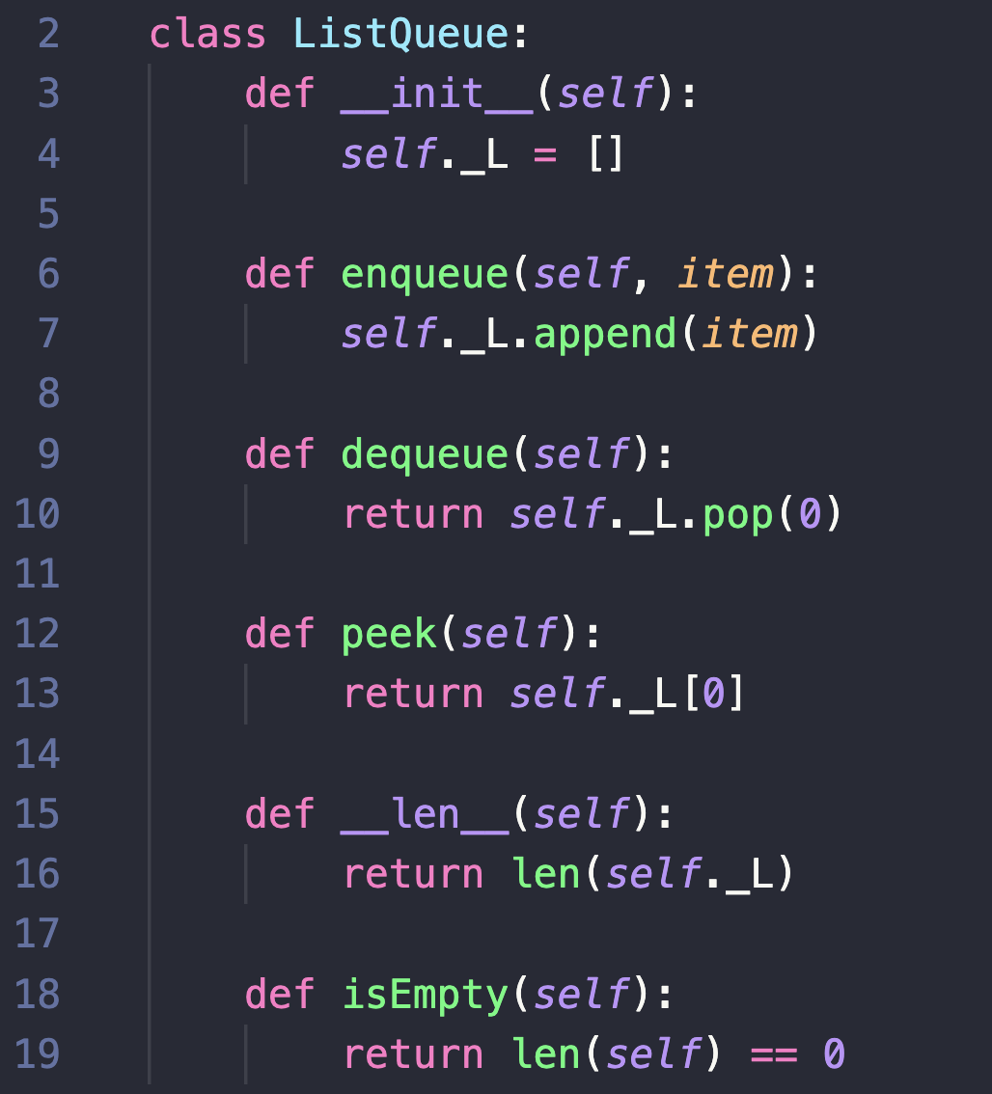
The Queue ADT
Implementation: Using a Python List

Slide 24
The Queue ADT
Implementation: Using a Python List
13
enqueue(item)
11
5
9
2
6

Slide 25
The Queue ADT
Implementation: Using a Python List
dequeue()
11
5
9
2
6

Slide 26
The Queue ADT
Implementation: Using a Python List
peek()
11
5
9
2
6

Slide 27
The Queue ADT
Implementation: Using a Python List

Slide 28
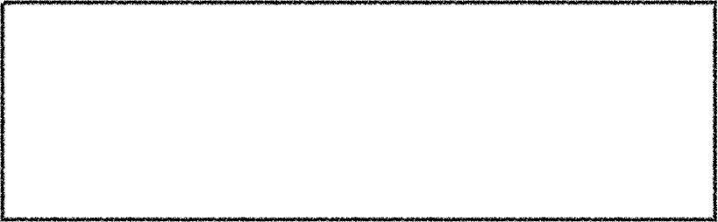
The Queue ADT
Running Time Analysis
O(1)
How can we fix this?
We could try popping from the end of the list.
But then we will have to insert at the beginning, which is also O(n).
O(n)
O(1)
O(1)
O(1)

Slide 29
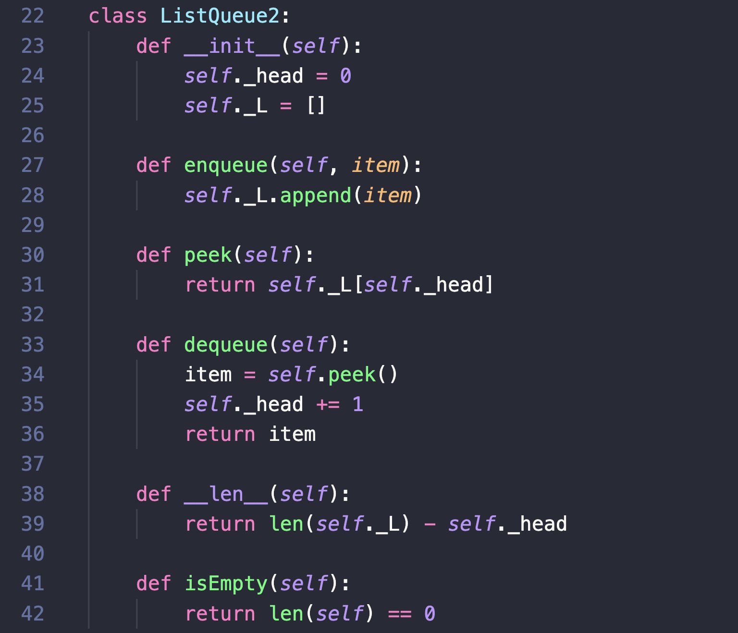
The Queue ADT
Implementation: Python List with Lazy Updates

Slide 30

The Queue ADT
Implementation: Python List with Lazy Updates
dequeue()
11
5
9
2
6
head
We now have a O(1) dequeue method!
But…the items are never actually deleted. So we have a list that can grow without bounds. How do we fix this?

Slide 31
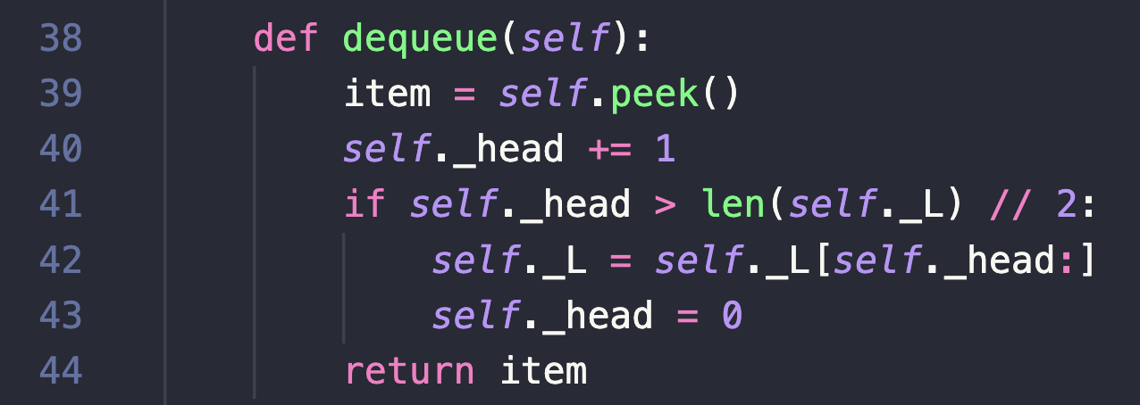
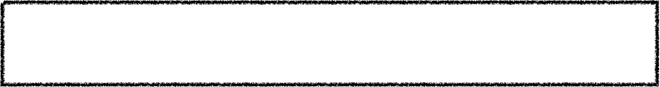
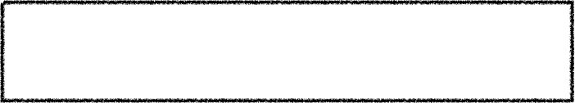
The Queue ADT
Implementation: Python List with Lazy Updates
dequeue()
11
5
9
2
6
head
If the list ever get half empty, we’ll replace it with a slice of the populated half.
2
6
Now we are cleaning up after ourselves, but how does this affect our running time?
head

Slide 32
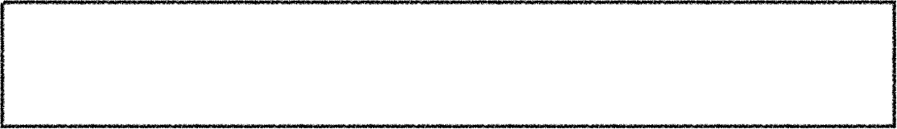
The Queue ADT
Lazy Update: Running Time Analysis
Imagine we’ve have enqueued 16 items.
1
2
3
4
5
6
7
8
9
10
11
12
13
14
15
16
Now imagine we want to dequeue all 16 items. What is the cost of these 16 dequeues?
Repeatedly dequeueing until the Queue is empty is the worst sequence of operations we could face.

Slide 33
The Queue ADT
Lazy Update: Running Time Analysis
Imagine we’ve have enqueued 16 items.
16 dequeue calls costs ~16 operations
1
2
3
4
5
6
7
8
9
10
11
12
13
14
15
16
Now imagine we want to dequeue all 16 items. What is the cost of these 16 dequeues?
After 8 dequeues, we have to copy items 9-16 into a new list.
9
10
11
12
13
14
15
16
After 4 more dequeues, we have to copy items 13-16 into a new list.
13
14
15
16
After 2 more dequeues, we have to copy items 15-16 into a new list.
15
16
After 1 more dequeue, we have to copy item 16 into a new list.
16
After 1 more dequeue, we create a new empty list.

Slide 34
The Queue ADT
Lazy Update: Running Time Analysis
Imagine we’ve have enqueued 16 items.
16 dequeue calls costs ~16 operations
1
2
3
4
5
6
7
8
9
10
11
12
13
14
15
16
Now imagine we want to dequeue all 16 items. What is the cost of these 16 dequeues?
After 8 dequeues, we have to copy items 9-16 into a new list.
9
10
11
12
13
14
15
16
After 4 more dequeues, we have to copy items 13-16 into a new list.
13
14
15
16
After 2 more dequeues, we have to copy items 15-16 into a new list.
15
16
After 1 more dequeue, we have to copy item 16 into a new list.
16
After 1 more dequeue, we create a new empty list.

Slide 35
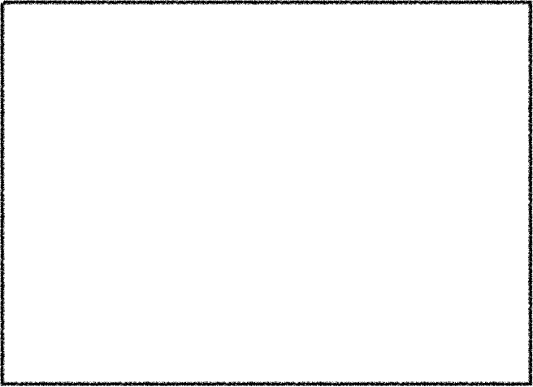
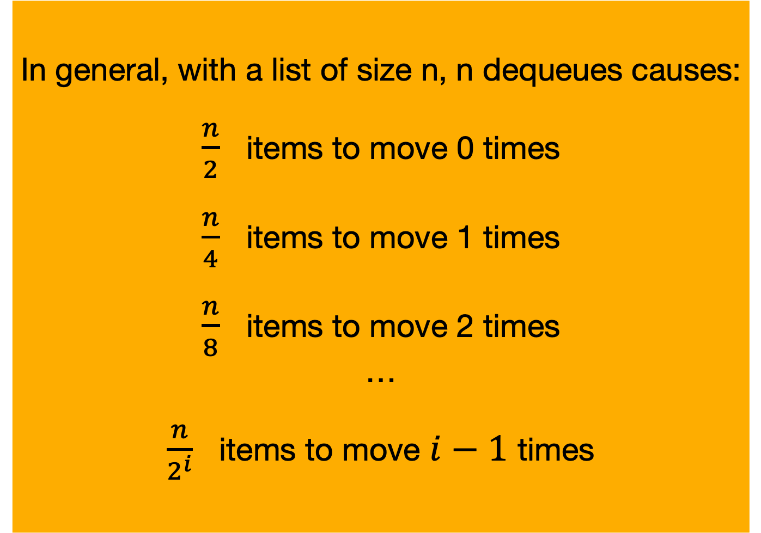
The Queue ADT
Lazy Update: Running Time Analysis
Imagine we’ve have enqueued 16 items.
16 dequeue calls costs ~16 operations
1
2
3
4
5
6
7
8
9
10
11
12
13
14
15
16
Now imagine we want to dequeue all 16 items. What is the cost of these 16 dequeues?
After 8 dequeues, we have to copy items 9-16 into a new list.
In general, with a list of size n, n dequeues causes:
$\frac{n}{2}$ items to move 0 times
$\frac{n}{4}$ items to move 1 times
$\frac{n}{8}$ items to move 2 times
…
$\frac{n}{2^{i}}$ items to move $i−1$ times
9
10
11
12
13
14
15
16
After 4 more dequeues, we have to copy items 13-16 into a new list.
13
14
15
16
After 2 more dequeues, we have to copy items 15-16 into a new list.
15
16
After 1 more dequeue, we have to copy item 16 into a new list.
16
After 1 more dequeue, we create a new empty list.

Slide 36

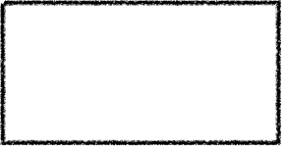
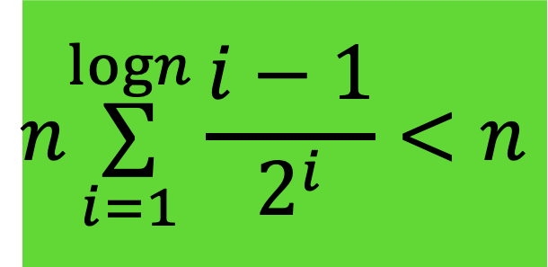
The Queue ADT
Lazy Update: Running Time Analysis
Imagine we’ve have enqueued 16 items.
16 dequeue calls costs ~16 operations
1
2
3
4
5
6
7
8
9
10
11
12
13
14
15
16
Now imagine we want to dequeue all 16 items. What is the cost of these 16 dequeues?
After 8 dequeues, we have to copy items 9-16 into a new list.
In general, with a list of size n, n dequeues causes:
$\frac{n}{2}$ items to move 0 times
$\frac{n}{4}$ items to move 1 times
$\frac{n}{8}$ items to move 3 times
…
$\frac{n}{2^{i}}$ items to move $i−1$ times
9
10
11
12
13
14
15
16
After 4 more dequeues, we have to copy items 13-16 into a new list.
13
14
15
16
After 2 more dequeues, we have to copy items 15-16 into a new list.
15
16
After 1 more dequeue, we have to copy item 16 into a new list.
16
$$n\overset{logn}{\underset{i=1}{∑}}\frac{i−1}{2^{i}}<n$$
So at worst, n dequeues causes about n items to be moved. On average, dequeue is O(1)!
After 1 more dequeue, we create a new empty list.

Slide 37
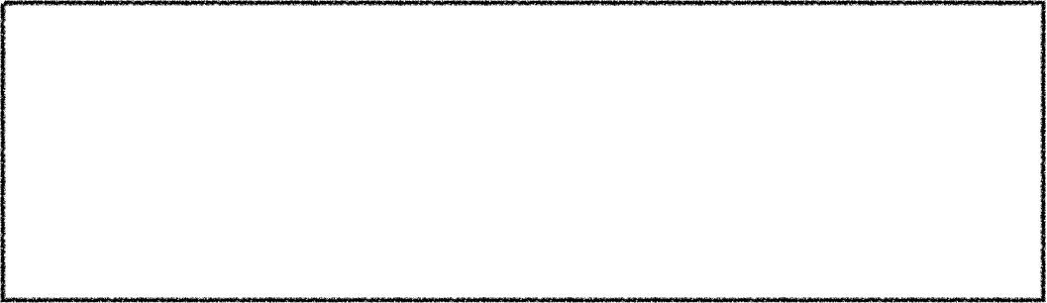
The Queue ADT
Lazy Update: Running Time Analysis
Imagine we’ve have enqueued 16 items.
16 dequeue calls costs ~16 operations
1
2
3
4
5
6
7
8
9
10
11
12
13
14
15
16
Now imagine we want to dequeue all 16 items. What is the cost of these 16 dequeues?
After 8 dequeues, we have to copy items 9-16 into a new list.
In general, with a list of size n, n dequeues causes:
$\frac{n}{2}$ items to move 0 times
$\frac{n}{4}$ items to move 1 times
$\frac{n}{8}$ items to move 3 times
…
$\frac{n}{2^{i}}$ items to move $i−1$ times
9
10
11
12
13
14
15
16
Amortized Analysis: average of the running times of operations in a sequence over number of operations performed within the sequence
After 4 more dequeues, we have to copy items 13-16 into a new list.
13
14
15
16
After 2 more dequeues, we have to copy items 15-16 into a new list.
15
16
After 1 more dequeue, we have to copy item 16 into a new list.
16
$$n\overset{logn}{\underset{i=1}{∑}}\frac{i−1}{2^{i}}<n$$
So at worst, n dequeues causes about n items to be moved. On average, dequeue is O(1)!
After 1 more dequeue, we create a new empty list.

Slide 38
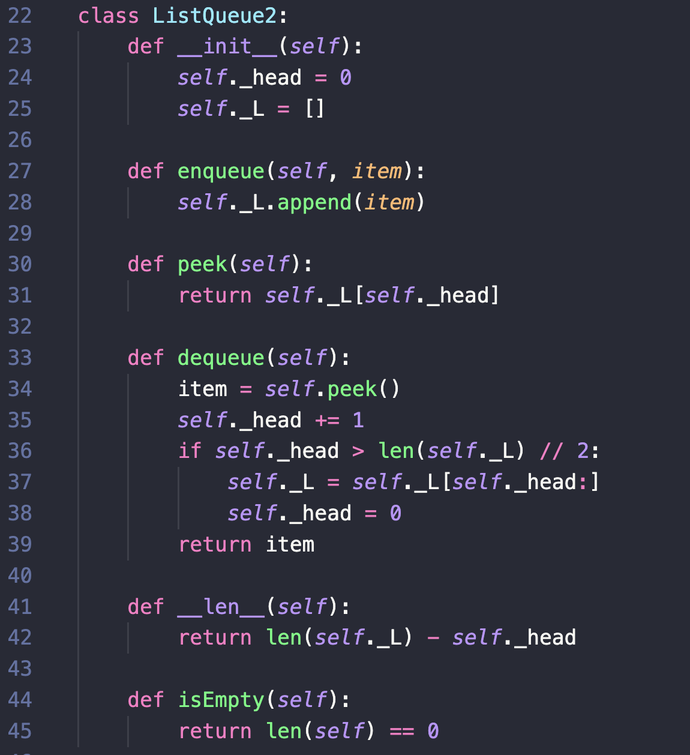
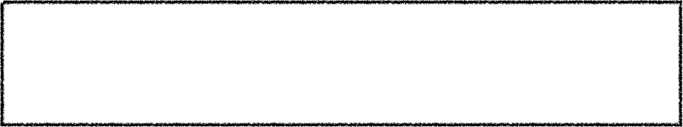
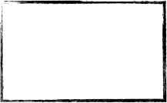
The Queue ADT
Running Time Analysis with Lazy Updates
O(1)
O(1)
So after all, we were able to implement an efficient Queue using a Python List!
O(1)
(amortized)
O(1)
O(1)

Slide 39
The Deque ADT (Doubly-ended queue)
Pronounced “deck”
A doubly-ended queue of items with the following behavior (i.e., methods)
add_first(item) : adds an item to the front of the deque
add_last(item) : adds an item to the back of the deque
remove_first() : removes and returns the item at the front of the deque
remove_last() : removes and returns the item at the back of the deque
len : returns the number of items in the deque ( __len__ magic method)

Slide 40
The Deque ADT (Doubly-ended queue)
Example
add_first(1)
add_first(3)
Deque
add_last(8)
remove_first()
Front
3
1
8
Back
—> 3
remove_last()
—> 8
remove_last()
—> 1

Slide 41
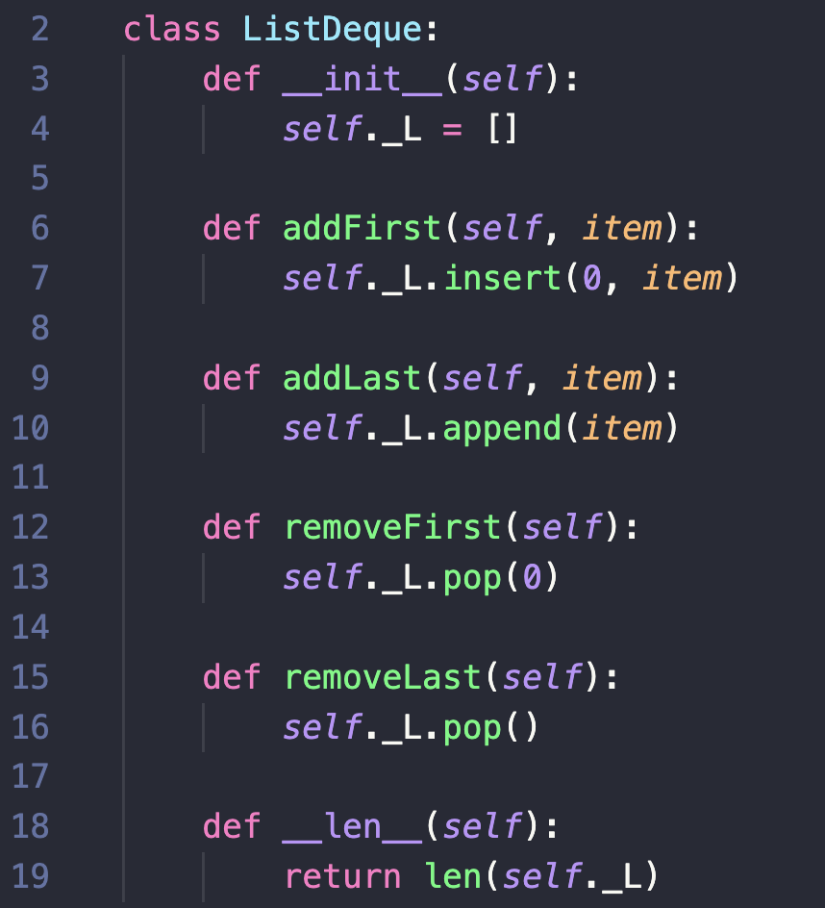
The Deque ADT
Implementation: Python List Limitations
Front
Back
11
5
9
2
6

Slide 43
Dealing With Errors

Slide 44
Dealing With Errors
Will this code cause an error?

Slide 46
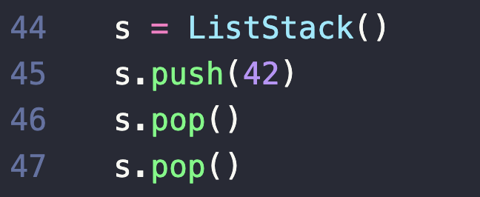
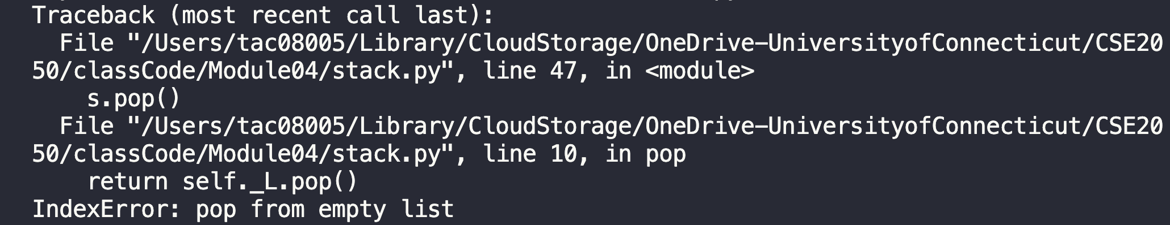
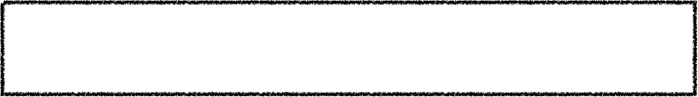
Dealing With Errors
Will this code cause an error?
User: “What list?” I’m using a Stack. We should make the error more meaningful for our user.

Slide 47

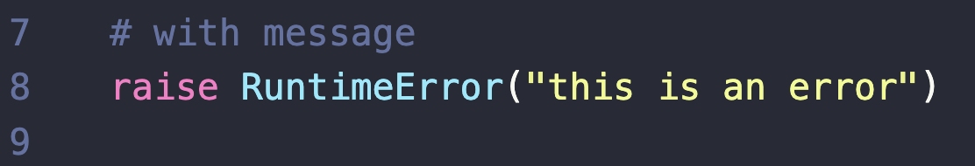
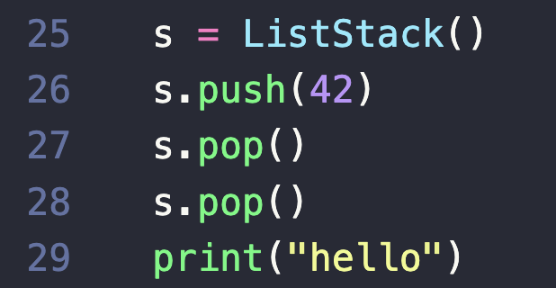
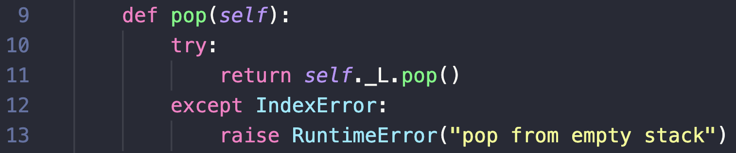
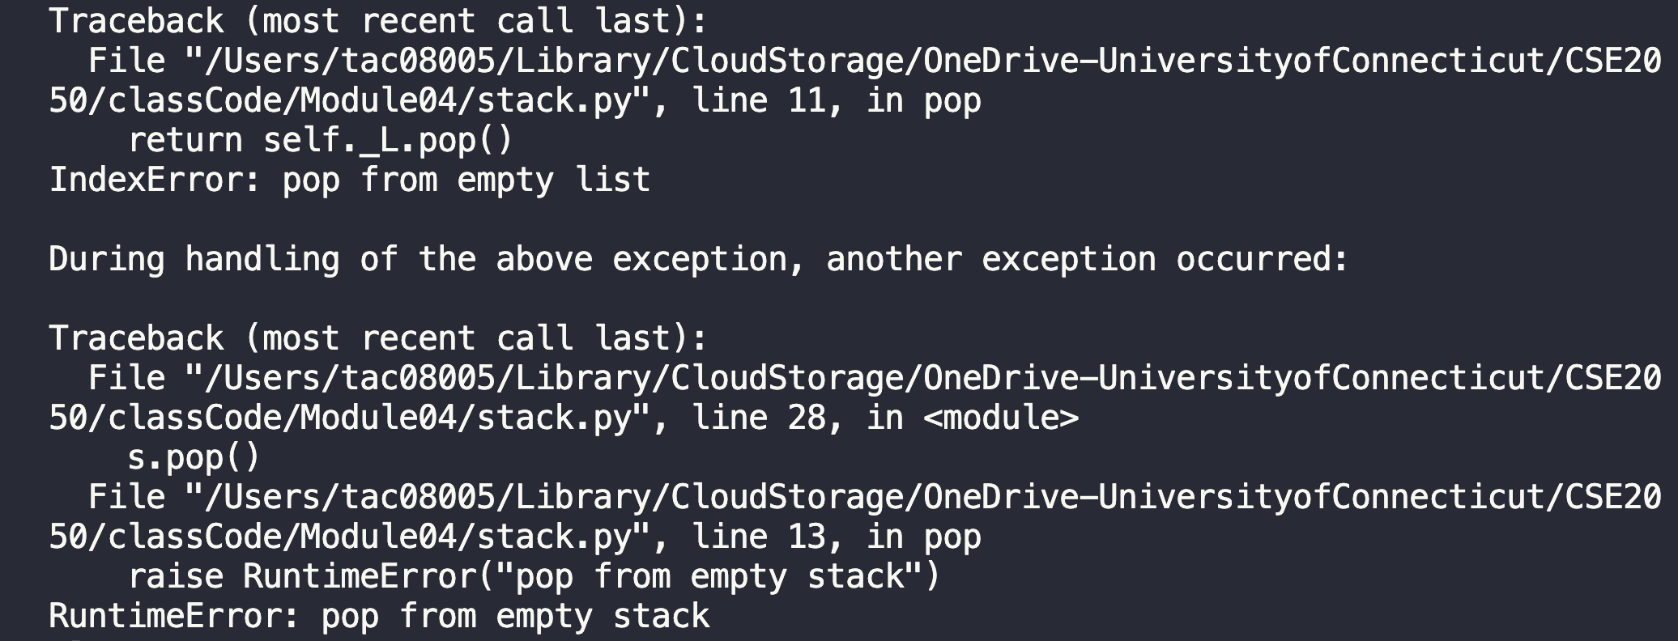
Dealing With Errors
Python Try-Except Blocks
In Python, we can raise an error using the raise keyword
The error can
be caught and handled specifically by using a try-except block, or
cause the program to crash

Slide 48
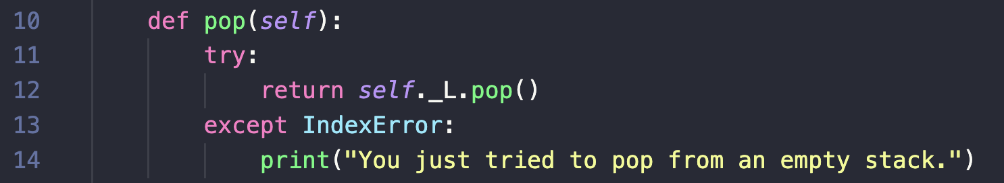
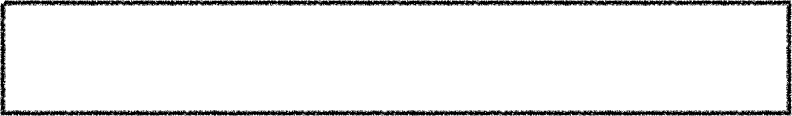
Dealing With Errors
Python Try-Except Blocks
In Python, we can raise an error using the raise keyword
The error can
be caught and handled specifically by using a try-except block, or
cause the program to crash
Alternatively, we could avoid a crash
Here, crashing is probably the right choice because it is never good to pop from an empty stack.

Slide 49
Start Recording

Slide 50
Recap
Stack
Stack
Last In, First Out
Introduced abstract data types (ADTs) and the wrapper pattern
Stack
Collection with LIFO ordering
Implemented efficiently with Python List
Queue
Collection with FIFO ordering
Implemented efficiency with Python List and lazy updates
Deque
Arbitrary ordering
Implemented efficiency with Python List and lazy updates
8
3
1
Queue
First In, First Out
8
3
1
Errors

Slide 52
Concrete Data Structure
Abstract Data Type
List (lazy update)
Linked List
Linked List (tail pointer)
Doubly Linked List
Stack
List
push()
O(1)*
O(1)*
pop()
O(1)*
O(1)*
Queue
enqueue()
O(1)* or O(n)
O(1)*
dequeue()
O(n) or O(1)*
O(1)*
Deque
add_first()
O(n) or O(1)*
O(1)*
remove_first()
O(n) or O(1)*
O(1)*
add_last()
O(1)* or O(n)
O(1)*
remove_last()
O(1)* or O(n)
O(1)*
* denotes amortized running time

Slide 53
class Deque:
def __init__(self):
"""Initializes an empty deque"""
self._L = []
def add_first(self, item):
"""Adds item to "front" of deque"""
self._L.insert(0, item)
def add_last(self, item):
"""Adds item to "end" of deque"""
self._L.append(item)
def remove_first(self):
"""Removes and returns first item in deque"""
return self._L.pop(0)
def remove_last(self):
"""Removes and returns last item in deque"""
return self._L.pop()

Slide 54
class Deque:
def __init__(self):
"""Initializes an empty deque"""
self._L = []
def add_first(self, item):
"""Adds item to "front" of deque"""
self._L.insert(0, item)
def add_last(self, item):
"""Adds item to "end" of deque"""
self._L.append(item)
def remove_first(self):
"""Removes and returns first item in deque"""
return self._L.pop(0)
def remove_last(self):
"""Removes and returns last item in deque"""
return self._L.pop()

Slide 55
class Deque:
def __init__(self):
"""Initializes an empty deque"""
self._L = []
def add_first(self, item):
"""Adds item to "front" of deque"""
self._L.insert(0, item)
def add_last(self, item):
"""Adds item to "end" of deque"""
self._L.append(item)
def remove_first(self):
"""Removes and returns first item in deque"""
return self._L.pop(0)
def remove_last(self):
"""Removes and returns last item in deque"""
return self._L.pop()
We have a problem. Storing our items sequentially in memory is preventing an efficient implementation.
Lazy updates:
Add memory overhead
Only give us amortized O(1)
O(1)
O(n)
O(1)*
O(n)
O(1)*

Slide 56
Linked Lists

Slide 57
So Far…
We’ve implemented three ADTs — Stack, Queue, and Deque
Only used a Python List for the underlying data structure
Stack — efficient implementation using end of list as the top of stack
Queue/Deque — efficient implementation using lazy updates
But now, the Python List will not be enough for us…

Slide 58
Linked Lists
A Data Structure to Store Sequential Collections
A list of individual nodes that are linked together
Each node contains two things: a piece of data and a link to the next node in the list
data
link
ListNode
data
link
data
link
data
link
data
link
data
link
None
LinkedList

Slide 59
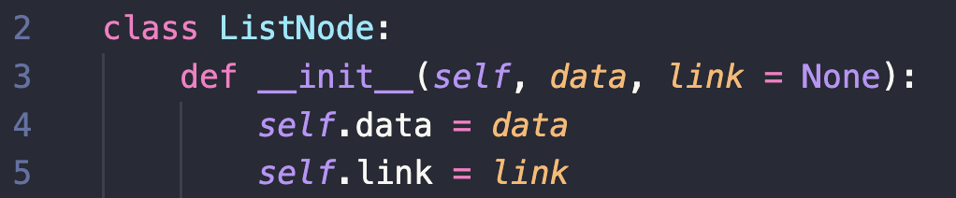
Linked Lists
A Data Structure to Store Sequential Collections
data
link
ListNode
Now we need a LinkedList class
data
link
data
link
data
link
data
link
data
link
None
LinkedList

Slide 60
Linked Lists
A Data Structure to Store Sequential Collections
data
link
data
link
data
link
data
link
data
link
None
LinkedList
LinkedList
head
How can we organize the whole linked list inside a class?
Store a reference to the front item (the head); access the rest of the linked list from there

Slide 61

Linked Lists
add_first and remove_first
add_first(1)
01
02
03
04
05
06
07
08
09
10
11
class LinkedList:
def __init__(self):
self._head = None
def add_first(self, data):
self._head = Node(data, link=self._head)
def remove_first(self):
item = self._head.data
self._head = self._head.link
return item
1
link
None
head

Slide 62
Linked Lists
add_first and remove_first
add_first(1)
01
02
03
04
05
06
07
08
09
10
11
class LinkedList:
def __init__(self):
self._head = None
def add_first(self, data):
self._head = Node(data, link=self._head)
def remove_first(self):
item = self._head.data
self._head = self._head.link
return item
1
link
None
head

Slide 63
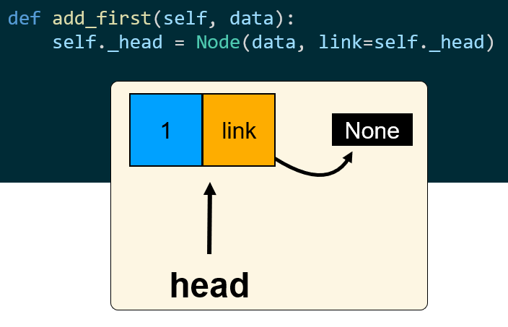

Slide 64
Linked Lists
add_first and remove_first
add_first(3)
01
02
03
04
05
06
07
08
09
10
11
class LinkedList:
def __init__(self):
self._head = None
def add_first(self, data):
self._head = Node(data, link=self._head)
def remove_first(self):
item = self._head.data
self._head = self._head.link
return item
3
link
1
link
None
head

Slide 65
Linked Lists
add_first and remove_first
remove_first()
01
02
03
04
05
06
07
08
09
10
11
class LinkedList:
def __init__(self):
self._head = None
def add_first(self, data):
self._head = Node(data, link=self._head)
def remove_first(self):
item = self._head.data
self._head = self._head.link
return item
3
link
1
link
None
head
item
3

Slide 66
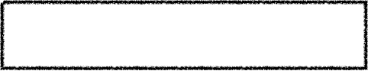
Linked Lists
Running Times?
add_first and remove_first
01
02
03
04
05
06
07
08
09
10
11
class LinkedList:
def __init__(self):
self._head = None
def add_first(self, data):
self._head = Node(data, link=self._head)
def remove_first(self):
item = self._head.data
self._head = self._head.link
return item
3
link
1
link
None
head

Slide 67
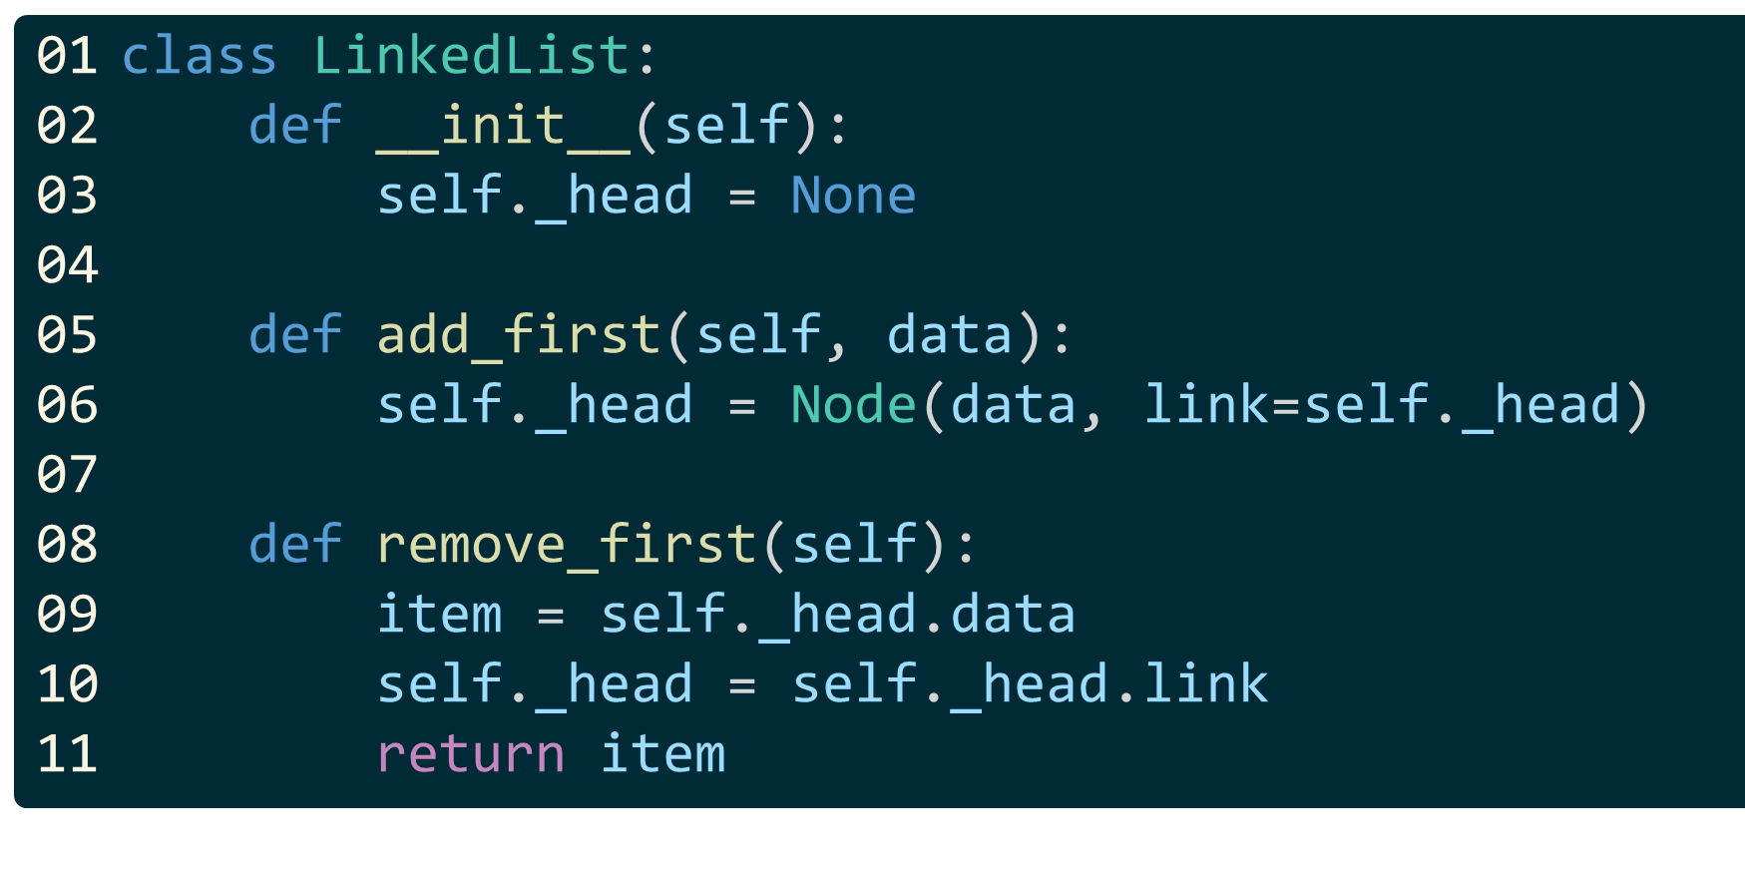

Slide 68
Linked Lists
Running Times?
add_first and remove_first
01
02
03
04
05
06
07
08
09
10
11
class LinkedList:
def __init__(self):
self._head = None
def add_first(self, data):
self._head = Node(data, link=self._head)
def remove_first(self):
item = self._head.data
self._head = self._head.link
return item
3
link
1
link
None
O(1)
head
O(1)

Slide 69
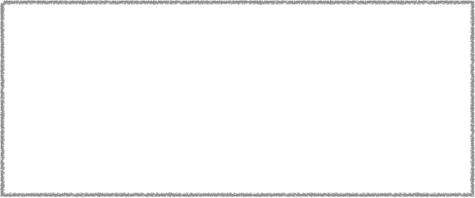

Linked Lists
add_last and remove_last
add_last(8)
01
02
03
class LinkedList:
def __init__(self):
self._head = None
head
def add_last(self, data):
if self._head is None: return self.add_first(data) current_node = self._head
while current_node.link is not None:
current_node = current_node.link current_node.link = Node(data, link=None)
def remove_last(self):
if self._head.link is None:
return self.remove_first()
current_node = self._head
while current_node.link.link is not None:
current_node = current_node.link item = current_node.link.data
current_node.link = None
return item
04
05
06
07
08
09
10
11
12
13
14
15
16
17
18
19
20
3
link
1
link
None

Slide 70
Linked Lists
add_last and remove_last
add_last(8)
01
02
03
class LinkedList:
def __init__(self):
self._head = None
head
def add_last(self, data):
if self._head is None: return self.add_first(data) current_node = self._head
while current_node.link is not None:
current_node = current_node.link current_node.link = Node(data, link=None)
def remove_last(self):
if self._head.link is None:
return self.remove_first()
current_node = self._head
while current_node.link.link is not None:
current_node = current_node.link item = current_node.link.data
current_node.link = None
return item
04
05
06
07
08
09
10
11
12
13
14
15
16
17
18
19
20
3
link
1
link
None

Slide 71
Linked Lists
add_last and remove_last
add_last(8)
01
02
03
class LinkedList:
def __init__(self):
self._head = None
head
def add_last(self, data):
if self._head is None: return self.add_first(data) current_node = self._head
while current_node.link is not None:
current_node = current_node.link current_node.link = Node(data, link=None)
def remove_last(self):
if self._head.link is None:
return self.remove_first()
current_node = self._head
while current_node.link.link is not None:
current_node = current_node.link item = current_node.link.data
current_node.link = None
return item
04
05
06
07
08
09
10
11
12
13
14
15
16
17
18
19
20
3
link
1
link
None
current_node

Slide 72
Linked Lists
add_last and remove_last
add_last(8)
01
02
03
class LinkedList:
def __init__(self):
self._head = None
head
def add_last(self, data):
if self._head is None: return self.add_first(data) current_node = self._head
while current_node.link is not None:
current_node = current_node.link current_node.link = Node(data, link=None)
def remove_last(self):
if self._head.link is None:
return self.remove_first()
current_node = self._head
while current_node.link.link is not None:
current_node = current_node.link item = current_node.link.data
current_node.link = None
return item
04
05
06
07
08
09
10
11
12
13
14
15
16
17
18
19
20
3
link
1
link
None
current_node

Slide 73

Linked Lists
add_last and remove_last
add_last(8)
01
02
03
class LinkedList:
def __init__(self):
self._head = None
head
def add_last(self, data):
if self._head is None: return self.add_first(data) current_node = self._head
while current_node.link is not None:
current_node = current_node.link current_node.link = Node(data, link=None)
def remove_last(self):
if self._head.link is None:
return self.remove_first()
current_node = self._head
while current_node.link.link is not None:
current_node = current_node.link item = current_node.link.data
current_node.link = None
return item
04
05
06
07
08
09
10
11
12
13
14
15
16
17
18
19
20
3
link
1
link
8
link
None
None
current_node

Slide 74
Linked Lists
add_last and remove_last
remove_last()
01
02
03
class LinkedList:
def __init__(self):
self._head = None
head
def add_last(self, data):
if self._head is None: return self.add_first(data) current_node = self._head
while current_node.link is not None:
current_node = current_node.link current_node.link = Node(data, link=None)
def remove_last(self):
if self._head.link is None:
return self.remove_first()
current_node = self._head
while current_node.link.link is not None:
current_node = current_node.link item = current_node.link.data
current_node.link = None
return item
04
05
06
07
08
09
10
11
12
13
14
15
16
17
18
19
20
3
link
1
link
8
link
None
None
current_node
item
8

Slide 75
def add_last(self, data):
if self._head is None: return self.add_first(data) current_node = self._head
while current_node.link is not None:
current_node = current_node.link current_node.link = Node(data, link=None)
def remove_last(self):
if self._head.link is None:
return self.remove_first()
current_node = self._head
while current_node.link.link is not None:
current_node = current_node.link item = current_node.link.data
current_node.link = None
return item

Slide 76
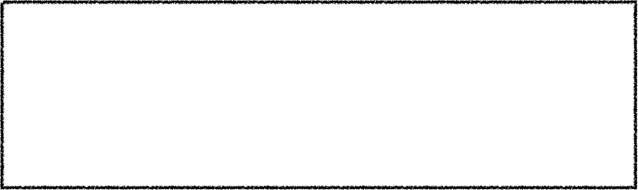
Linked Lists
Running Times?
add_last and remove_last
01
02
03
class LinkedList:
def __init__(self):
self._head = None
head
def add_last(self, data):
if self._head is None: return self.add_first(data) current_node = self._head
while current_node.link is not None:
current_node = current_node.link current_node.link = Node(data, link=None)
def remove_last(self):
if self._head.link is None:
return self.remove_first()
current_node = self._head
while current_node.link.link is not None:
current_node = current_node.link item = current_node.link.data
current_node.link = None
return item
04
05
06
07
08
09
10
11
12
13
14
15
16
17
18
19
20
3
link
1
link
8
link
None
None
O(n)
O(n)
This traversal is inefficient! Instead, let’s also keep a reference to the end of the list.

Slide 77
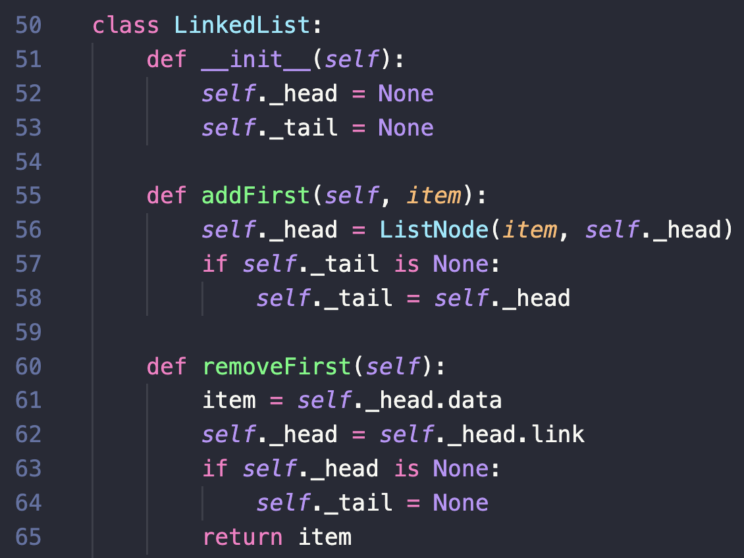
Linked Lists
addFirst and removeFirst
addFirst(1)
head
1
link
None
tail

Slide 78
Linked Lists
addFirst and removeFirst
addFirst(3)
head
3
link
1
link
None
tail

Slide 79
Linked Lists
addFirst and removeFirst
removeFirst()
head
3
link
1
link
None
tail
item
3

Slide 80
Linked Lists
Running Times?
addFirst and removeFirst
head
3
link
1
link
None
tail

Slide 81
Linked Lists
Running Times?
addFirst and removeFirst
head
O(1)
3
link
1
link
None
O(1)
tail

Slide 82
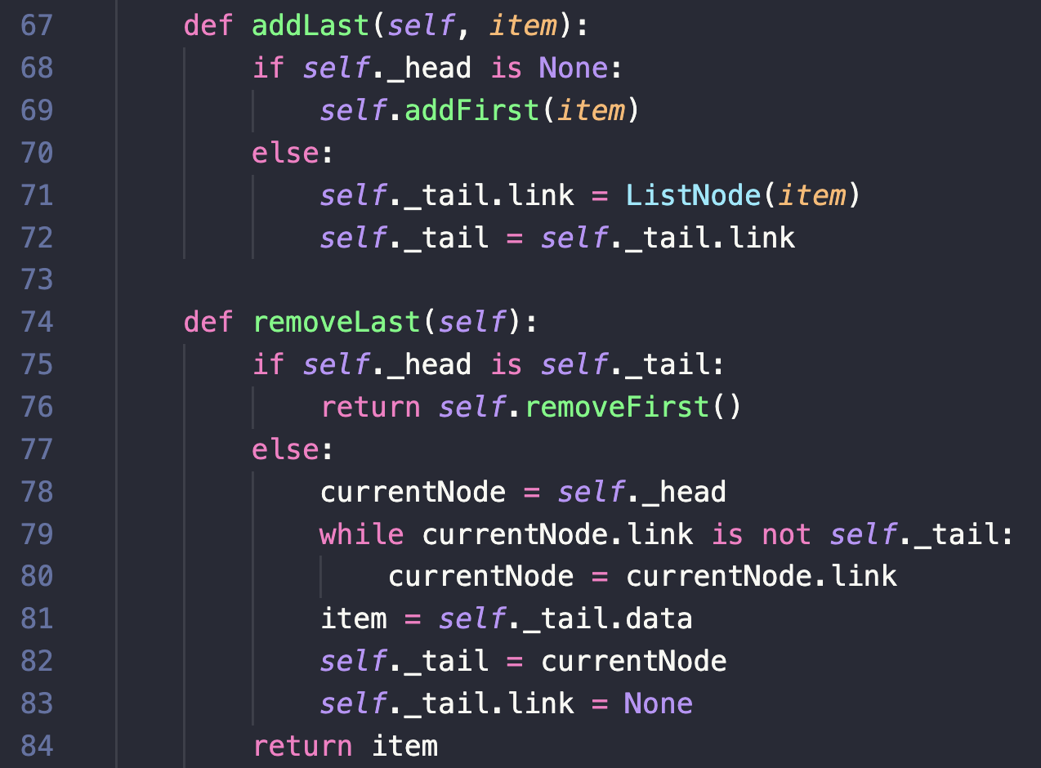



Linked Lists
addLast and removeLast
addLast(8)
head
3
link
1
link
8
link
None
None
tail

Slide 83
Linked Lists
addLast and removeLast
removeLast()
head
3
link
1
link
8
link
None
None
currentNode
tail
item
8

Slide 84
Linked Lists
Running Times?
addLast and removeLast
head
3
link
1
link
8
link
None
None
tail

Slide 86
Linked Lists
Running Times?
addLast and removeLast
head
3
link
1
link
8
link
O(1)
None
None
tail
O(n)
This traversal is inefficient! Instead, let’s have each node also keep a link to the previous node.

Slide 87
Concrete Data Structure
Abstract Data Type
List (lazy update)
Linked List
Linked List (tail pointer)
Stack
List
push()
O(1)*
O(1)*
O(1)
O(1)
pop()
O(1)*
O(1)*
O(1)
O(1)
Queue
enqueue()
O(1)* or O(n)
O(1)*
O(1)
O(1)
dequeue()
O(n) or O(1)*
O(1)*
O(1)
O(1)
Deque
add_first()
O(n) or O(1)*
O(1)*
O(1) or O(n)
O(1)
remove_first()
O(n) or O(1)*
O(1)*
O(1) or O(n)
O(1) or O(n)
add_last()
O(1)* or O(n)
O(1)*
O(n) or O(1)
O(1)
remove_last()
O(1)* or O(n)
O(1)*
O(n) or O(1)
O(n) or O(1)
* denotes amortized running time

Slide 89
Start Recording

Slide 90
Node
Node
Node
Node
Node
data
link
data
link
data
link
data
link
data
link
None
LinkedList
Instances of a class are namespaces, with every name mapped to an object
_head
int
_len
5
func
add_first()
???
func
add_last()
???
remove_first()
func
func
remove_last()
???
???

Slide 91
Concrete Data Structure
Abstract Data Type
List (lazy update)
Linked List
Linked List (tail pointer)
Stack
List
push()
O(1)*
O(1)*
O(1)
O(1)
pop()
O(1)*
O(1)*
O(1)
O(1)
Queue
enqueue()
O(1)*
O(n)
O(1)*
O(1)
O(n)
O(1)
O(n)
or
O(n)
or
O(1)
dequeue()
O(1)*
O(1)*
O(1)
Deque
add_first()
O(1)*
O(n)
O(1)*
O(1)
O(n)
O(1)
O(1)
remove_first()
O(1)*
O(n)
O(1)*
O(1)
O(n)
O(1)
O(n)
or
or
or
add_last()
O(n)
O(1)*
O(1)*
O(n)
O(1)
O(1)
O(1)
remove_last()
O(n)
O(1)*
O(1)*
O(n)
O(1)
O(n)
O(1)
* denotes amortized running time

Slide 92
Node
Node
Node
Node
Node
data
link
data
link
data
link
data
link
data
link
None
LinkedListWithTail
_head
_tail
_len
Keeping track of the tail speeds up add_last (but not remove_last)
add_first()
add_last()
remove_first()
It'd be nice if we didn't have to copy/paste our unittests....
remove_last()

Slide 93
Factory classes are classes used to make other classes.
A Test Factory contains a suite of tests that we want to repeat for e.g. 2 classes or 2 algorithms.
class TestLinkedFactory:
def setUp(self, _class):
self._class = _class
def test_init(self):
ll1 = self._class()
self.assertEqual(len(ll1), 0)
self.assertEqual(ll1.get_head(), None)
self.assertEqual(ll1.get_tail(), None)
# Add other tests in this class as desired
class TestLinkedList(TestLinkedFactory, unittest.TestCase):
def setUp(self):
return TestLinkedFactory.setUp(self, LinkedList)
class TestLinkedListTail(TestLinkedFactory, unittest.TestCase):
def setUp(self):
return TestLinkedFactory.setUp(self, LinkedListTail)
Normal unittest, but the class is a variable

Slide 94
Concrete Data Structure
Abstract Data Type
List (lazy update)
Linked List
Linked List (tail pointer)
Stack
List
push()
O(1)*
O(1)*
O(1)
O(1)
pop()
O(1)*
O(1)*
O(1)
O(1)
Queue
enqueue()
O(1)*
O(n)
O(1)*
O(1)
O(n)
O(1)
O(n)
or
O(n)
or
O(1)
dequeue()
O(1)*
O(1)*
O(1)
Deque
add_first()
O(1)*
O(n)
O(1)*
O(1)
O(n)
O(1)
O(1)
remove_first()
O(1)*
O(n)
O(1)*
O(1)
O(n)
O(1)
O(n)
or
or
or
add_last()
O(n)
O(1)*
O(1)*
O(n)
O(1)
O(1)
O(1)
remove_last()
O(n)
O(1)*
O(1)*
O(n)
O(1)
O(n)
O(1)
* denotes amortized running time
For O(1) on any end, we need a doubly linked list

Slide 95
Doubly Linked Lists

Slide 96
Doubly Linked Lists
A Data Structure to Store Sequential Collections
A list of individual nodes that are linked together
Each node contains three things:
a piece of data
link: a reference to the next node in the list
prev: a reference to the previous node in the list
prev
data
link
prev
data
link
prev
data
link
None
None
DoublyLinkedList

Slide 97
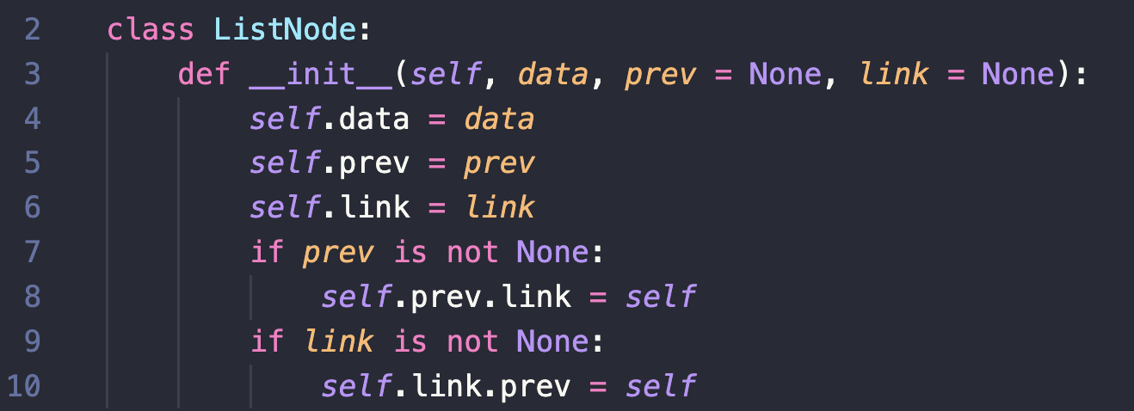
Doubly Linked Lists
A Data Structure to Store Sequential Collections
prev
data
link
ListNode

Slide 98
Doubly Linked Lists
A Data Structure to Store Sequential Collections
prev
data
link
ListNode
Now we need a DoublyLinkedList class
prev
data
link
prev
data
link
prev
data
link
None
None
DoublyLinkedList

Slide 99
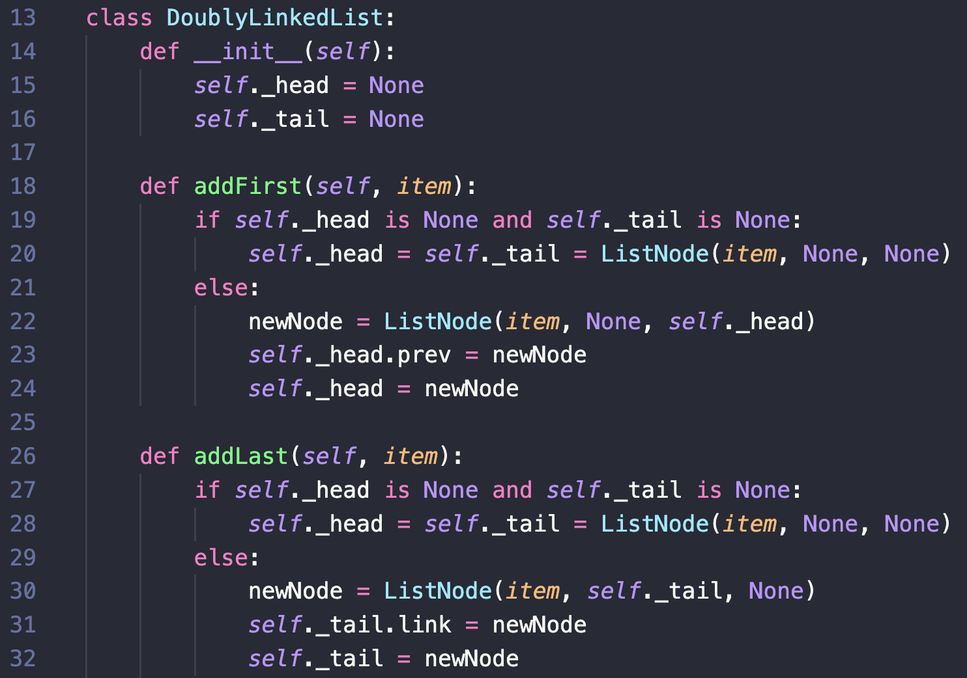

Doubly Linked Lists
addFirst and addLast
addFirst(1)
head
prev
1
link
None
None
None
tail

Slide 100
Doubly Linked Lists
addFirst and removeFirst
addFirst(3)
head
prev
3
link
prev
1
link
None
None
None
None
None
tail

Slide 101
Doubly Linked Lists
addFirst and addLast
addLast(3)
head
prev
1
link
prev
3
link
None
None
None
None
tail

Slide 102
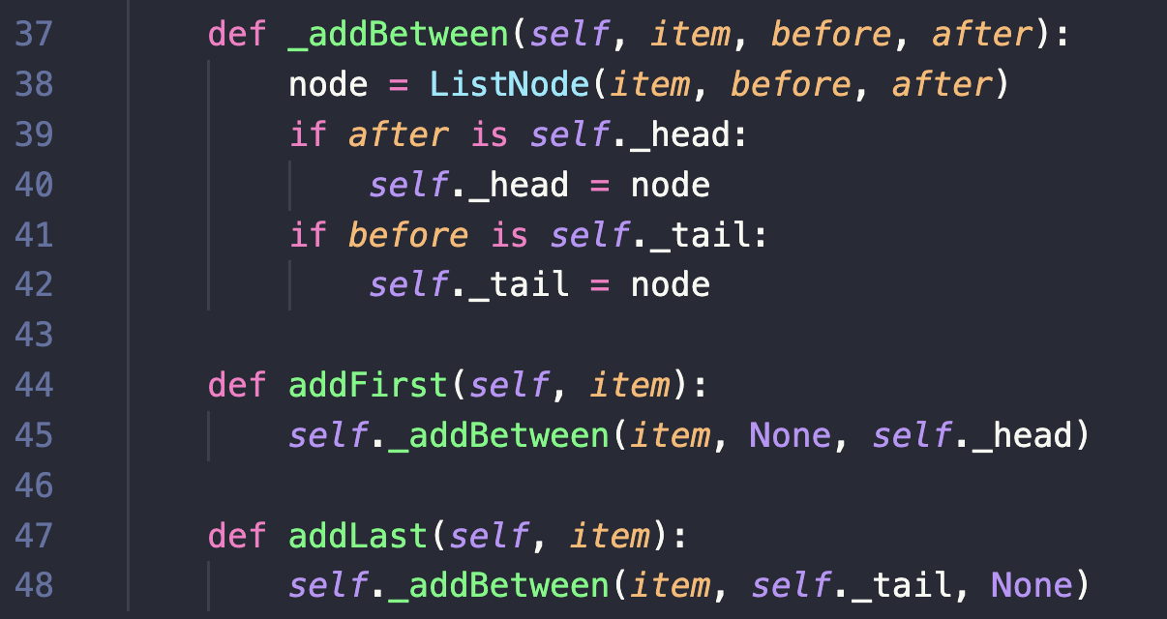
Doubly Linked Lists
addFirst and addLast
Refactor!

Slide 103
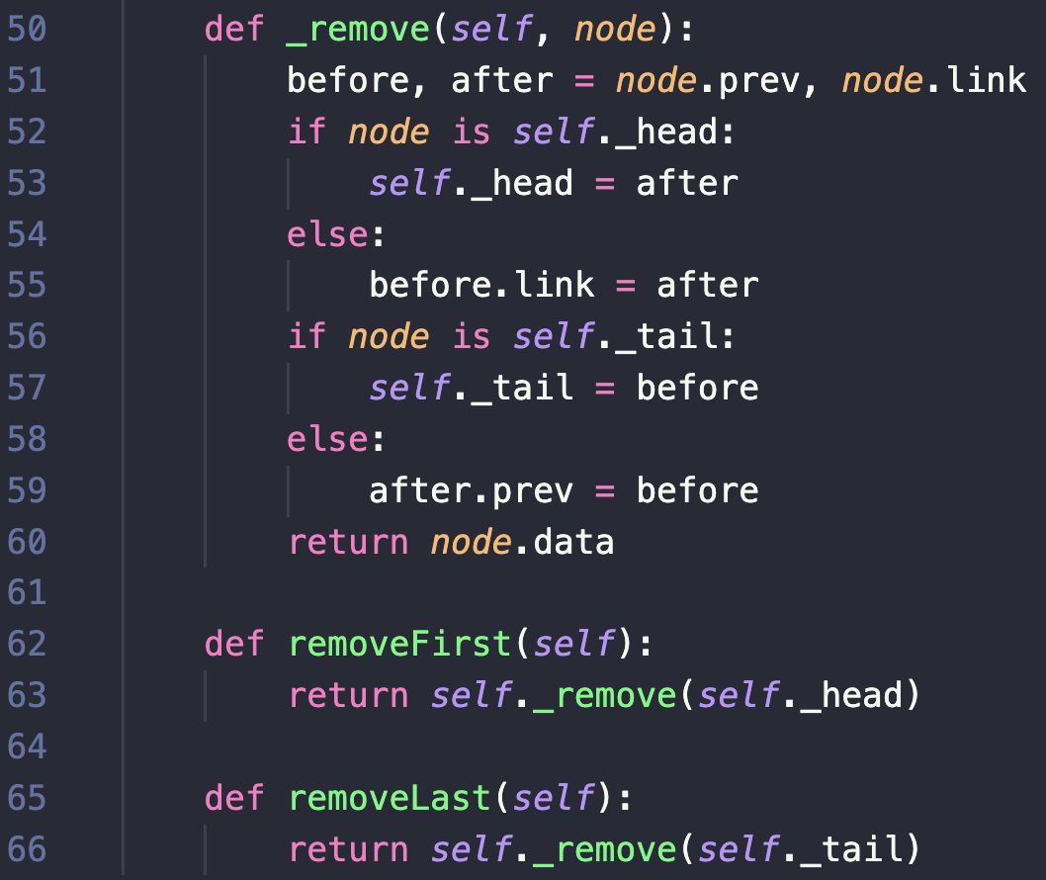

Doubly Linked Lists
removeFirst and removeLast
removeFirst()
before
head
None
prev
3
link
prev
1
link
prev
8
link
None
tail
node
after

Slide 105
Doubly Linked Lists
removeFirst and removeLast
removeFirst()
before
head
None
prev
3
link
prev
1
link
prev
8
link
None
tail
node
after
return 3

Slide 106
Doubly Linked Lists
removeFirst and removeLast
removeLast()
before
node
head
None
prev
3
link
prev
1
link
prev
8
link
None
tail
after

Slide 108
Doubly Linked Lists
Running Times?
removeFirst and removeLast
removeLast()
before
node
head
None
prev
3
link
prev
1
link
prev
8
link
None
tail
after
return 8

Slide 110
Doubly Linked Lists
Running Times?
removeFirst and removeLast
removeLast()
before
node
O(1)
head
None
prev
3
link
prev
1
link
prev
8
link
None
tail
after
O(1)
return 8
O(1)

Slide 111

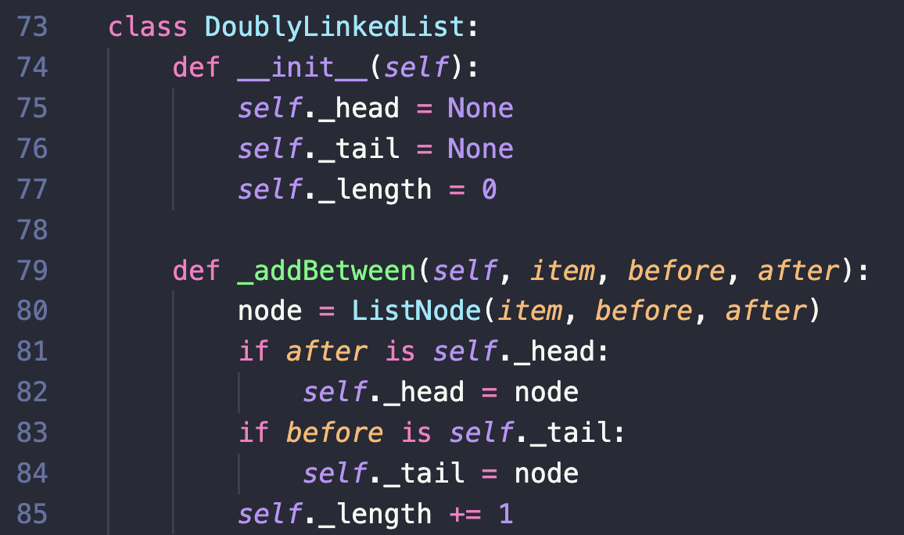
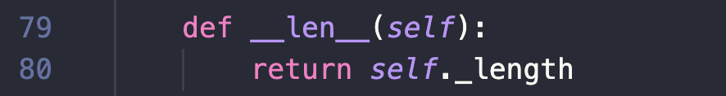
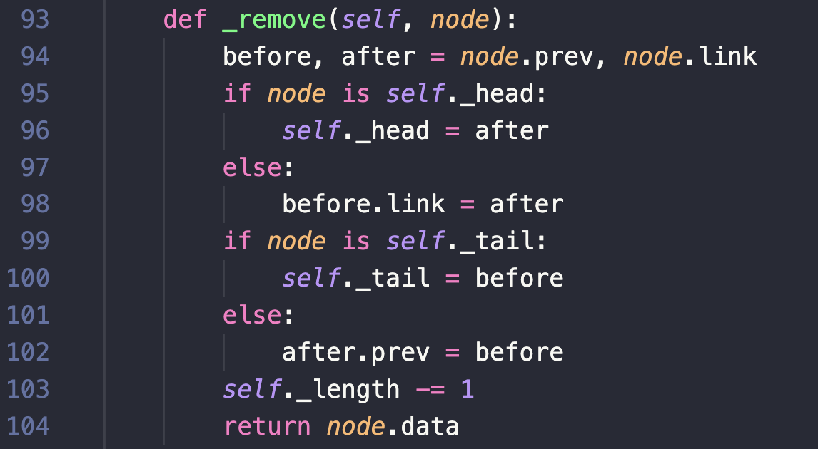
Doubly Linked Lists
__len__

Slide 112


Doubly Linked Lists
Can do all deque operations in constant time, O(1) !

Slide 113
Concrete Data Structure
Abstract Data Type
List (lazy update)
Linked List
Linked List (tail pointer)
Doubly Linked List
Stack
List
push()
O(1)*
O(1)*
O(1)
O(1)
O(1)
pop()
O(1)*
O(1)*
O(1)
O(1)
O(1)
Queue
enqueue()
O(1)* or O(n)
O(1)*
O(1)
O(1)
O(1)
dequeue()
O(n) or O(1)*
O(1)*
O(1)
O(1)
O(1)
Deque
add_first()
O(n) or O(1)*
O(1)*
O(1) or O(n)
O(1)
O(1)
remove_first()
O(n) or O(1)*
O(1)*
O(1) or O(n)
O(1) or O(n)
O(1)
add_last()
O(1)* or O(n)
O(1)*
O(n) or O(1)
O(1)
O(1)
remove_last()
O(1)* or O(n)
O(1)*
O(n) or O(1)
O(n) or O(1)
O(1)
* denotes amortized running time

Slide 115
Lazy Updates

Slide 116
Line Number Template
01
02
03
04
05
06
07
08
09
10
11
12
13
14
15
16
17
18
19

